Slide 1

Intro to JavaScript Tooling in Visual Studio Code
@scott_addie

Slide 2



About VS Code
Launched on April 29, 2015 at //Build/ conference
Beta release
Current = v0.10.11
Free product
Lightweight
Microsoft’s 1st cross-platform code editor

Slide 3

About VS Code (cont.)
An editor, not an IDE
Based on GitHub’s Electron shell
Designed by engineers who created:
Eclipse @ IBM
Monaco @ Microsoft
Built w/ web technologies

Slide 4

Instead of making them [Linux and Mac developers] go to Windows, we want to meet them where they are.
S. “Soma” Somasegar – Microsoft - Corporate VP of Developer Division
Quote retrieved from http://tcrn.ch/1PwSw1r

Slide 5
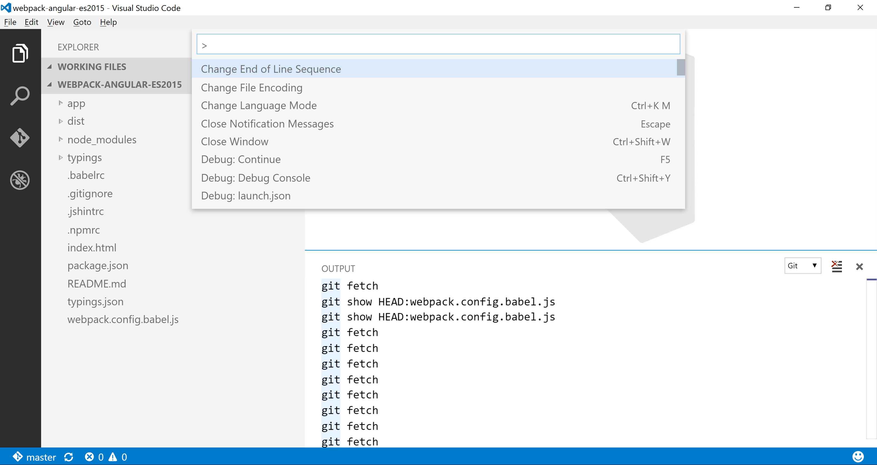
Command Palette
File Explorer
File Search
Git Tools
Debugger
Output Window
Git Repo Branch

Slide 6
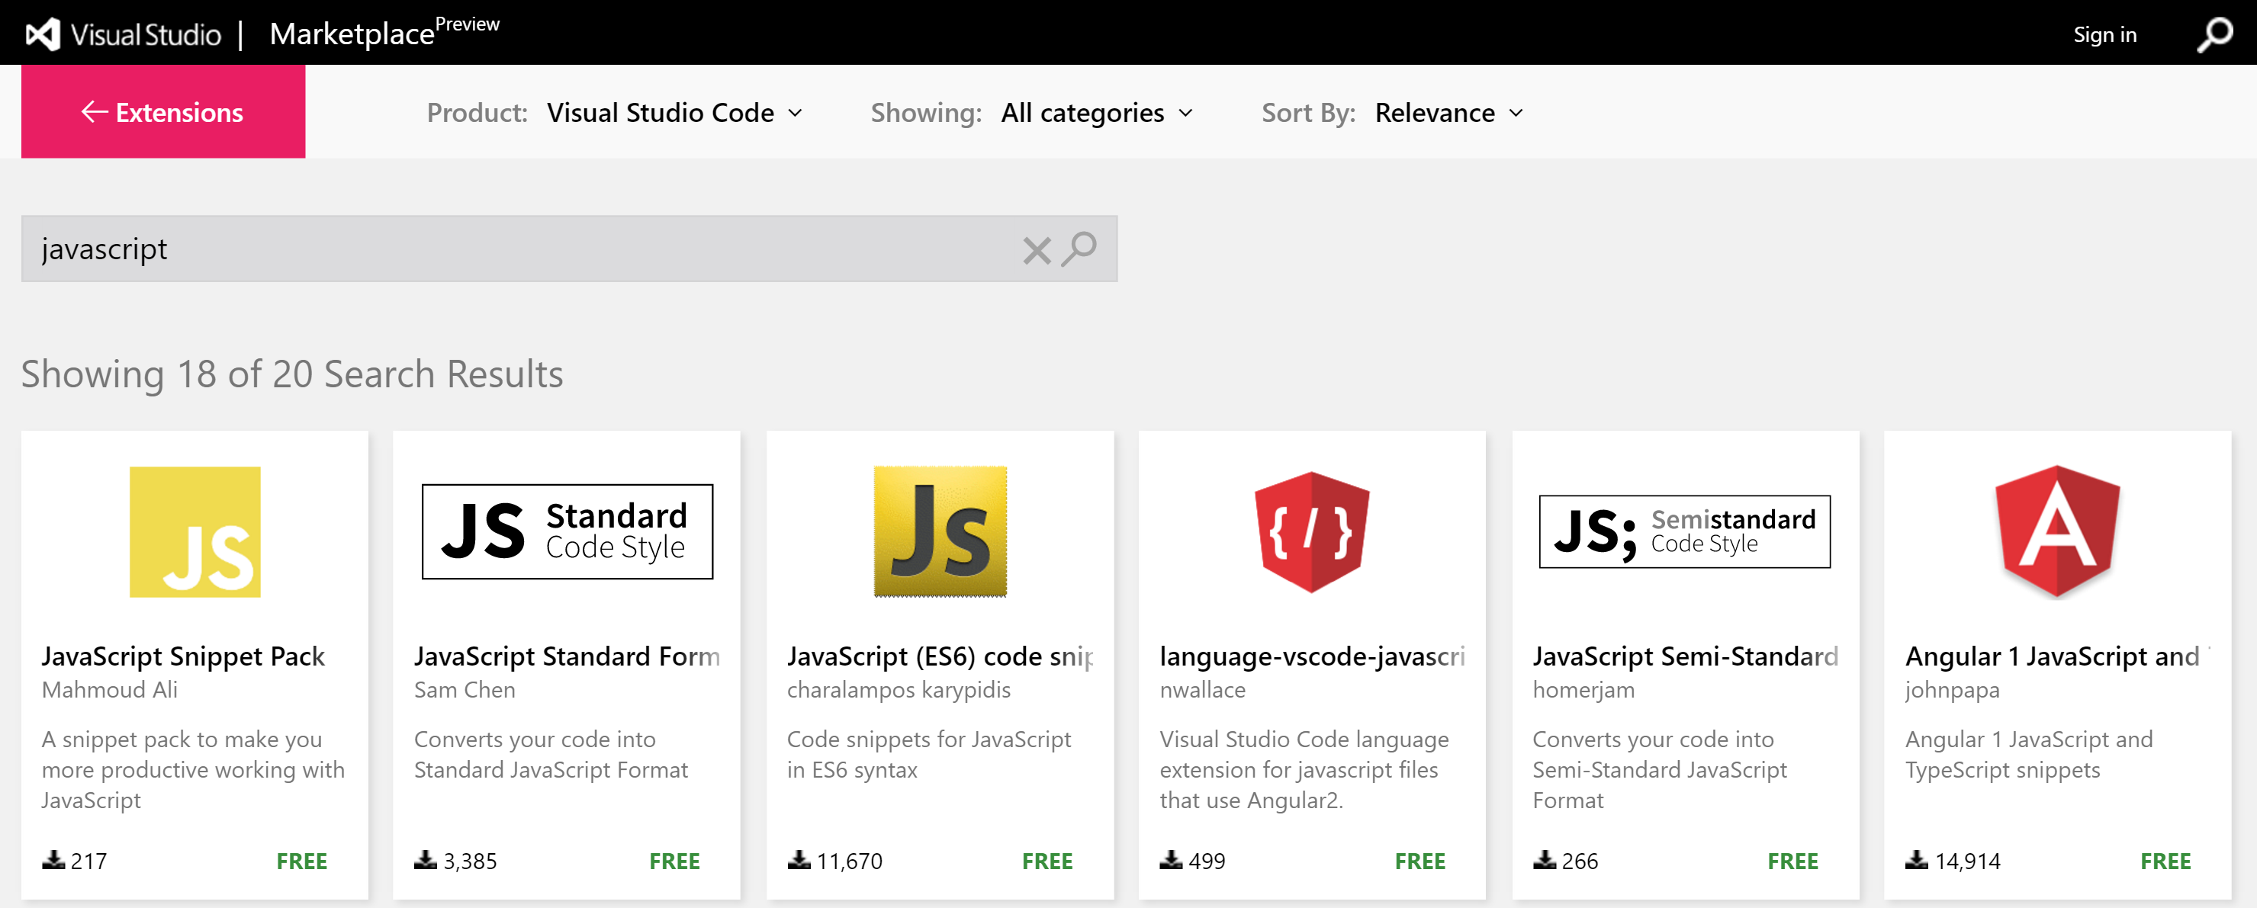
Extensibility v0.10.1 and above
marketplace.visualstudio.com/vscode

Slide 8
4 Notable JSON Configuration Files
File Name | Location | Common Uses
jsconfig.json | Project root or subfolder | Enable ECMAScript version support
launch.json | .vscode/ | Debugger configuration
settings.json | .vscode/ - or - %APPDATA%\Code\User\ | Override editor settings
tasks.json | .vscode/ | Define custom tasks to run w/ built-in task runner

Slide 9
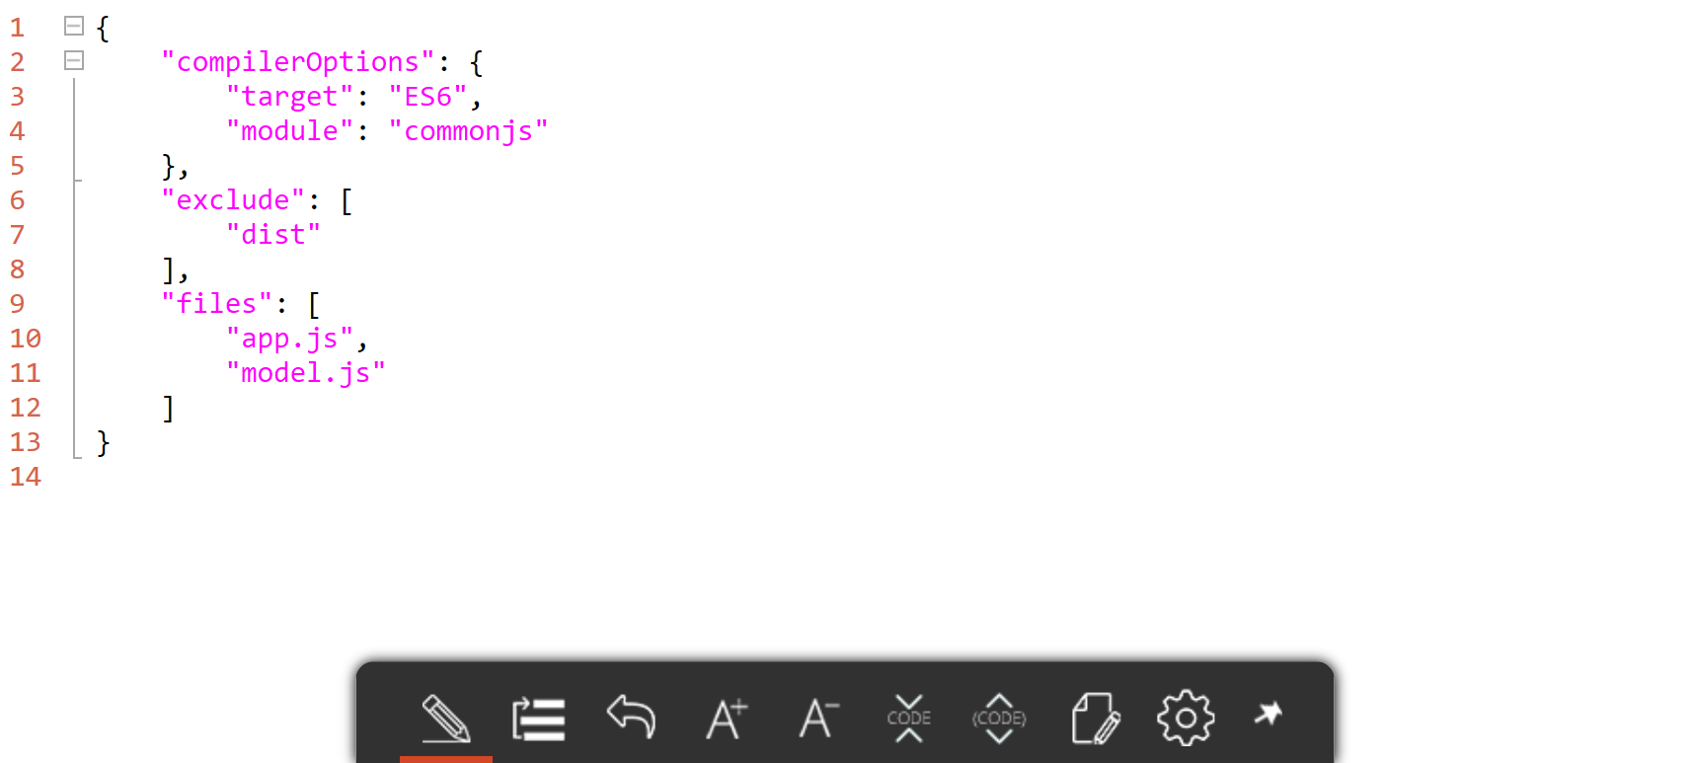
1. jsconfig.json

Slide 10
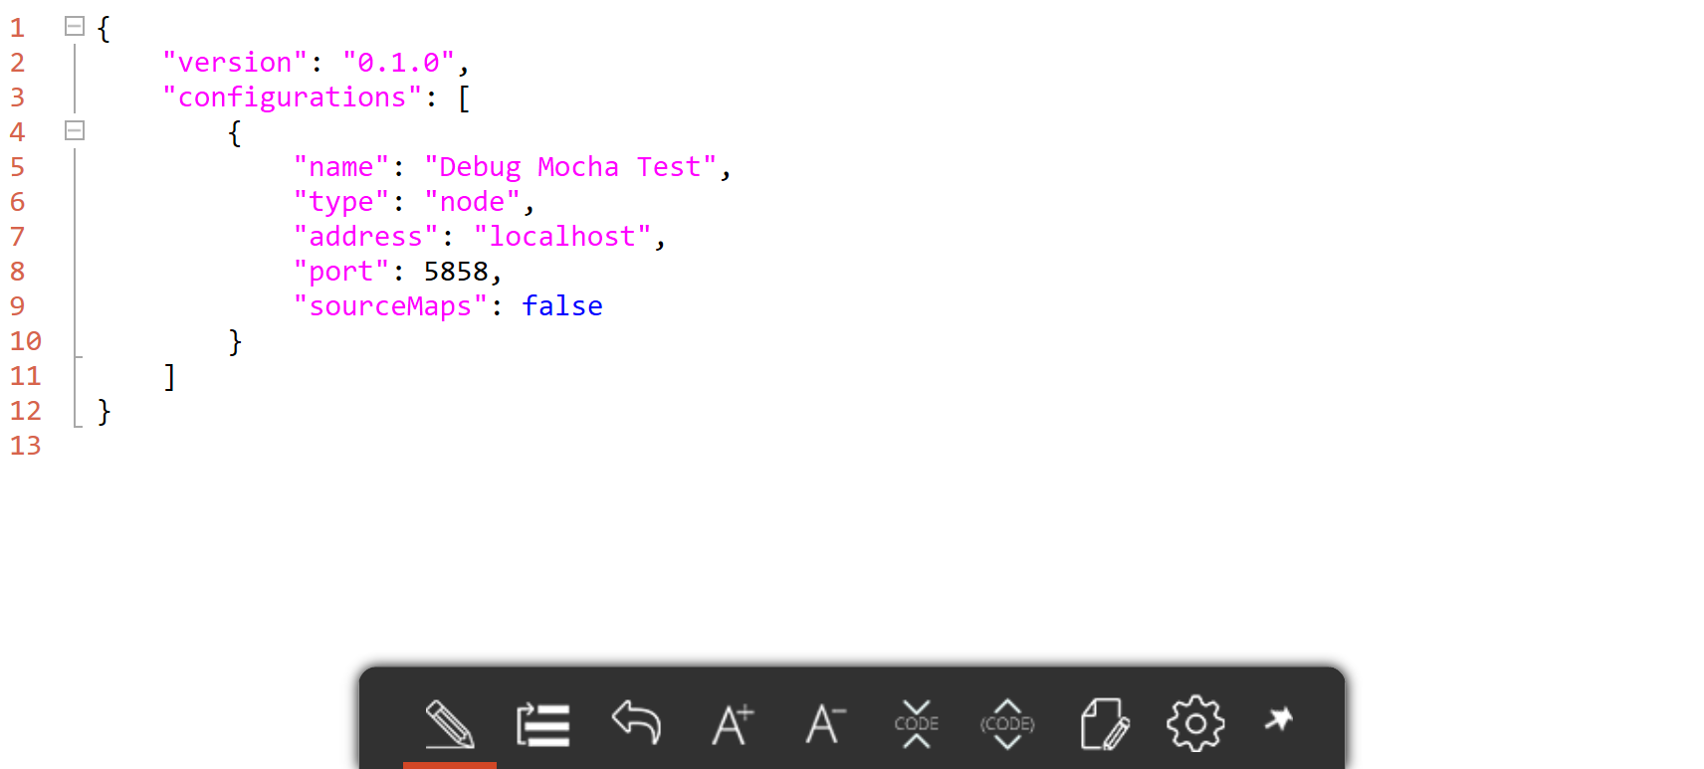
2. launch.json

Slide 11
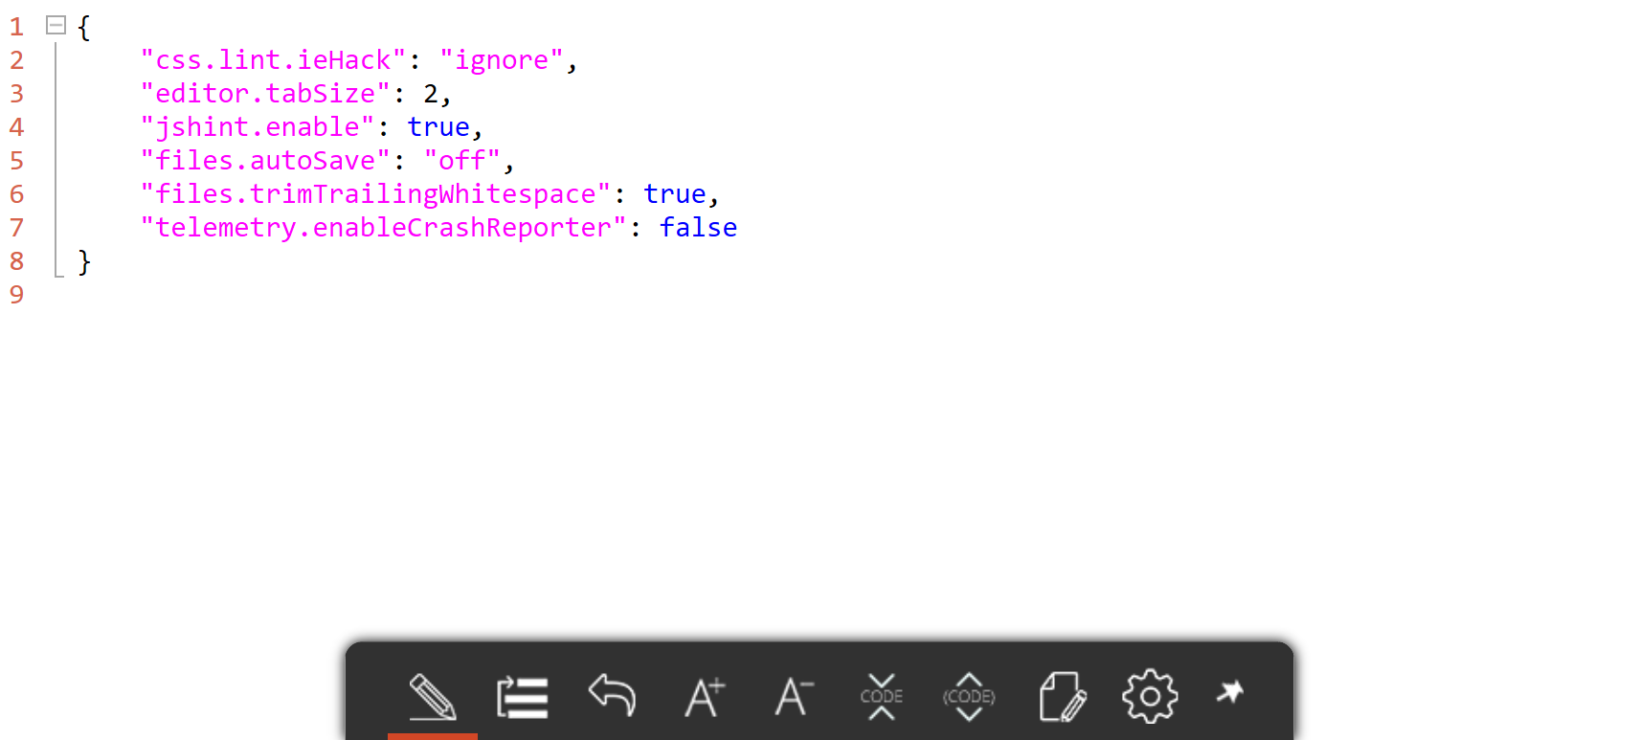
3. settings.json

Slide 12
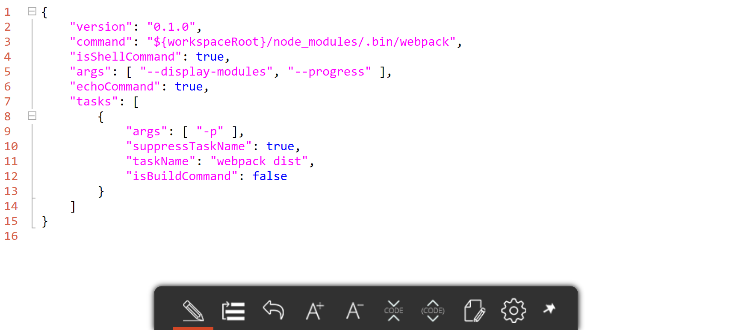
4. tasks.json

Slide 13
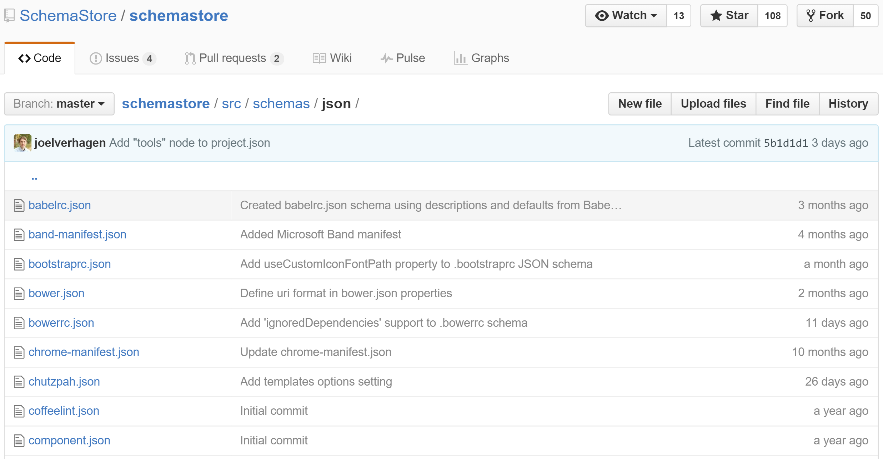
JSON Schema Support schemastore.org/json/

Slide 14
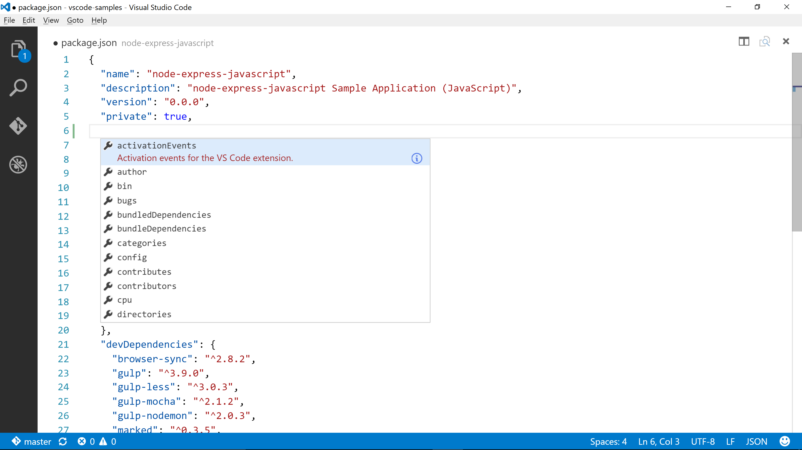
package.json Schema Support

Slide 15
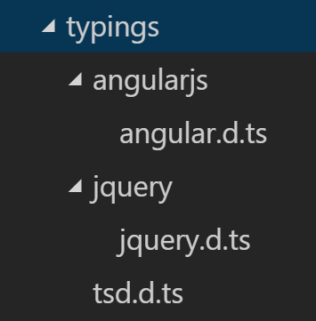
Library / Framework IntelliSense
Reliance on type definitions
Deprecated: TSD
Now: Typings
> npm install –g typings
*.d.ts files provide metadata to editor
angular.d.ts, jquery.d.ts, etc.

Slide 16
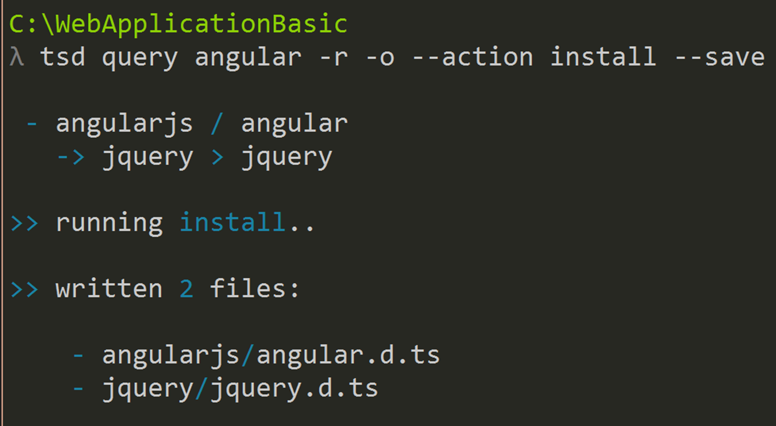
Enable IntelliSense via tsd

Slide 17
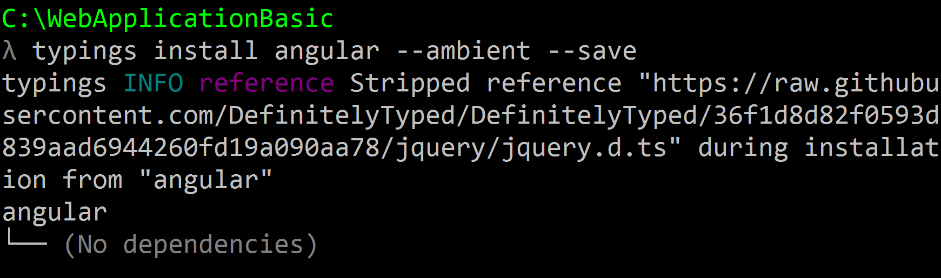
Enable IntelliSense via typings

Slide 18
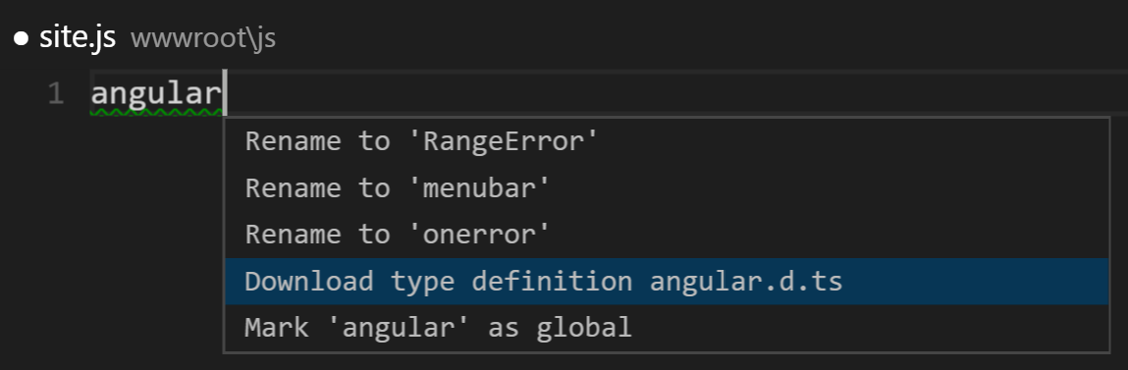
…or Enable IntelliSense via Editor v0.10.9 and below

Slide 19
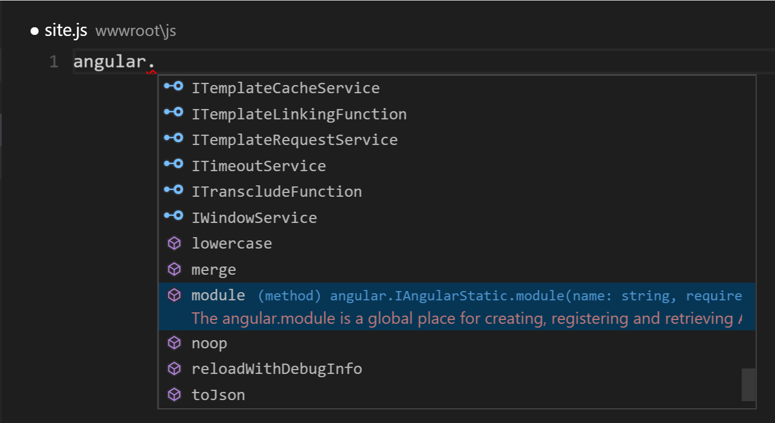
IntelliSense in Action

Slide 20

Demo
let demo = + ;
Enabling CommonJS & Webpack Support

Slide 21
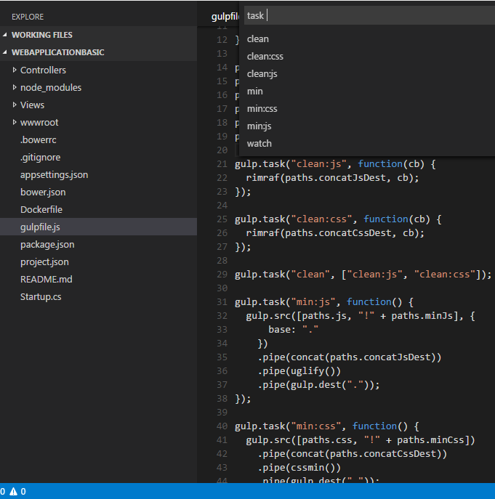
JS Task Runners
>Tasks: Run Task
Command Palette
Discoverable
Launchable
1st class support for:
Grunt
Gulp
Jake
Terminate running tasks:
>Tasks: Terminate Running Task

Slide 22
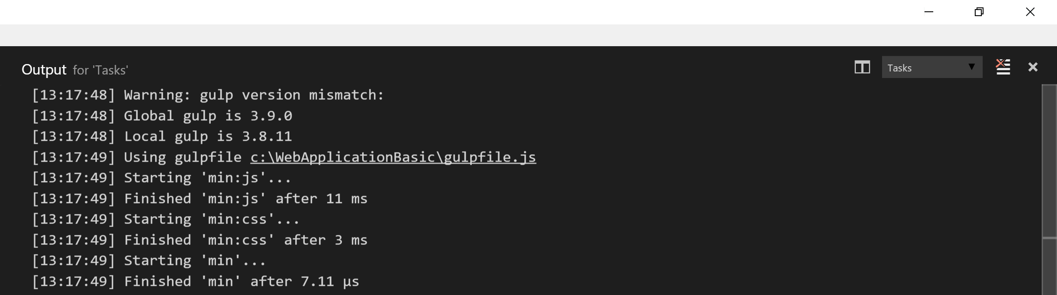
Task Output

Slide 23

Demo
let demo = + ;
Discovering, Launching, & Debugging Gulp Tasks

Slide 24
Native Task Runner
VS Code has its own task runner
Integrate w/ 3rd party tools:
Babel
Webpack
etc.
isBuildCommand property ties to Shift + Ctrl + B gesture
isTestCommand property ties to Shift + Ctrl + T gesture

Slide 25
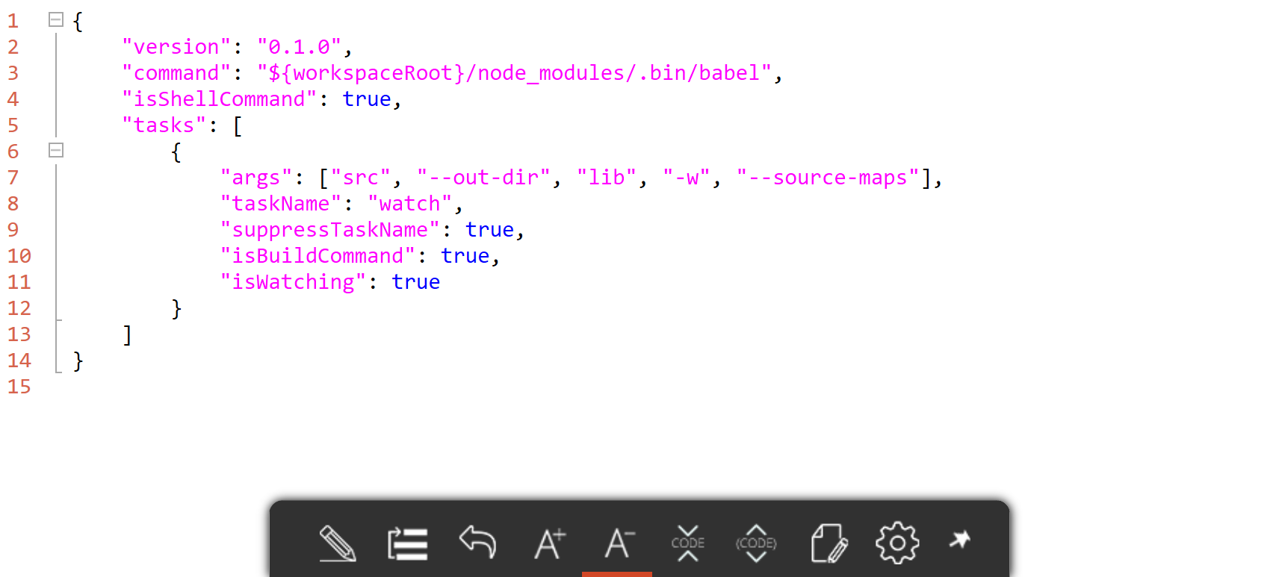
Babel Transpilation Task tasks.json

Slide 26

Demo
let demo = + ;
Running Custom Webpack Build Task

Slide 27
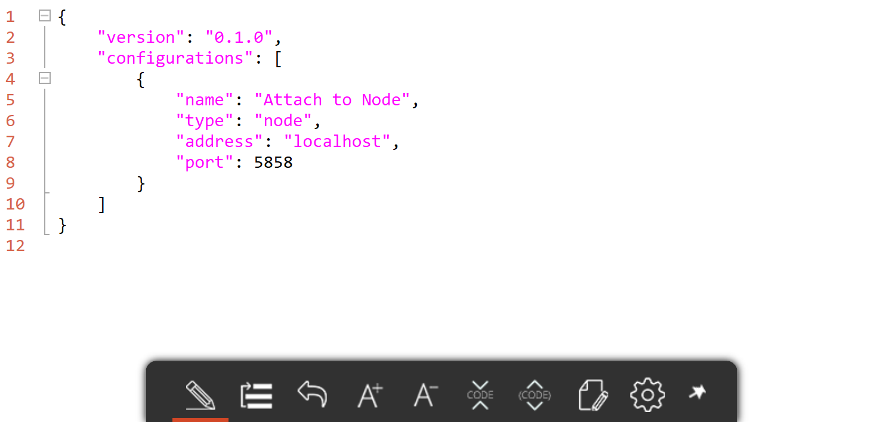
Node.js Debugging launch.json
Default launch configuration provided:

Slide 28
Node.js Debugging (cont.)
3 easy steps:
Configure launch.json for Node.js debugging
Launch Node.js program:
node --debug-brk program.js
Attach VS Code debugger to running program
--debug and --debug-brk supported
--debug-brk stops on 1st line of program

Slide 29

Demo
let demo = + ;
Debugging Mocha Unit Tests: Attach to Node Process

Slide 30
Resources
Official VS Code website
VS Code Docs
VS Code Source on GitHub
Visual Studio Code
John Papa, Pluralsight course
VS Code ES6 Sample Project

Slide 31
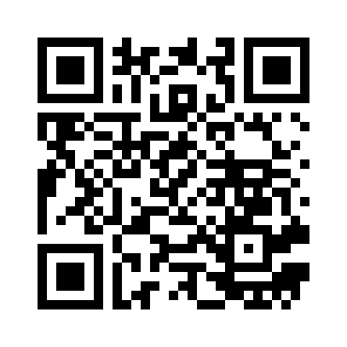




Thank you!
Scan QR for slides:
GitHub.com/scottaddie/slide-decks
ScottAddie.com
@Scott_Addie
LinkedIn.com/in/scottaddie

